Slide 1
Regression Analysis
Multiple Linear Regression
Nicoleta Serban, Ph.D.
Professor
School of Industrial and Systems Engineering
Assumptions and Diagnostics

Slide 2

About This Lesson

Slide 3
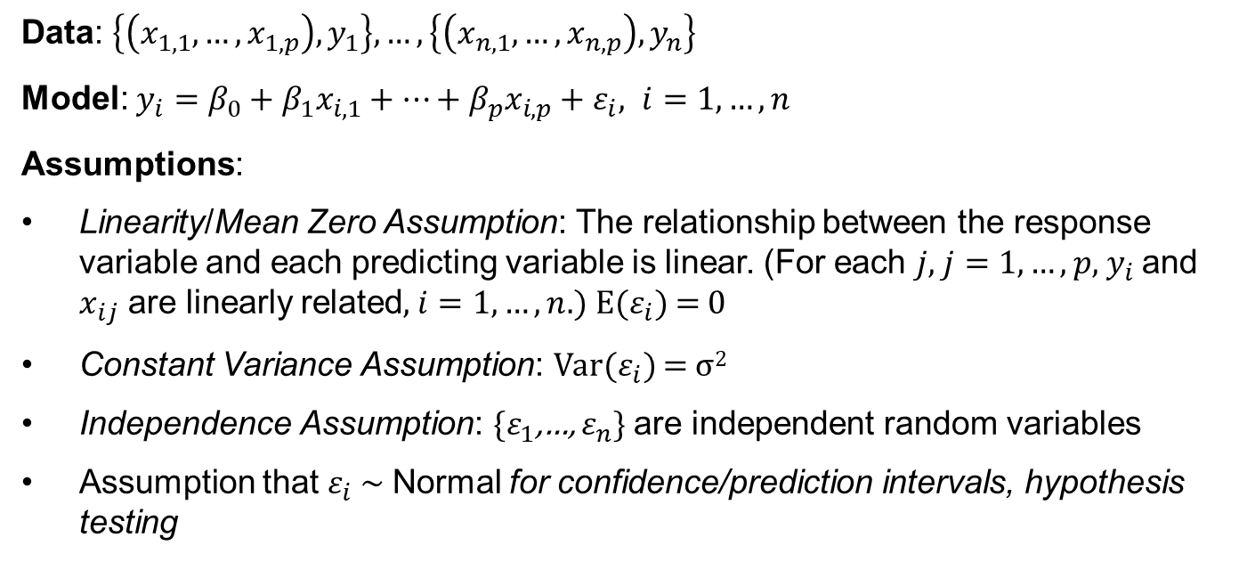
Multiple Linear Regression: Model
Data: $\left\{\left(x_{1,1},…,x_{1,p}\right),y_{1}\right\},…,\left\{\left(x_{n,1},…,x_{n,p}\right),y_{n}\right\}$
Model: $y_{i}=β_{0}+β_{1}x_{i,1}+…+β_{p}x_{i,p}+ε_{i}, i=1, …,n$
Assumptions:
Linearity/Mean Zero Assumption: The relationship between the response variable and each predicting variable is linear. (For each $j$, $j=1, …,p$, $y_{i}$and $x_{ij}$ are linearly related, $i=1, …,n$.) E($ε_{i}$) = 0
Constant Variance Assumption: Var($ε_{i}$) = σ²
Independence Assumption: {$ε_{1}$,…, $ε_{n}$} are independent random variables
Assumption that $ε_{i}$ ~ Normal for confidence/prediction intervals, hypothesis testing

Slide 4
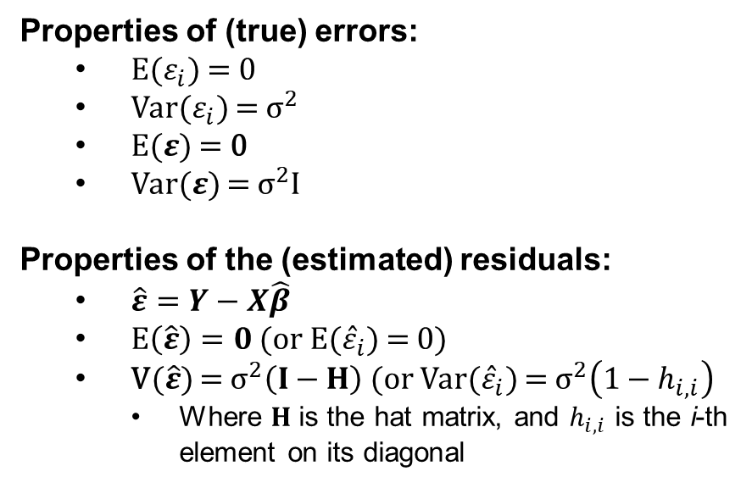
Properties of the Errors & Residuals
Properties of (true) errors:
  E($ε_{i}$) = 0
  Var($ε_{i}$) = ${\text{σ}}^{2}$
  E($ε$) = 0
  Var($ε$) = ${\text{σ}}^{2}I$
Properties of the (estimated) residuals:
  $\hat{ε}=Y−X\hat{β}$
  $E\left(\hat{ε}\right)=0$ (or E(${\hat{ε}}_{i}$) = 0)
  V($\hat{ε}$) = ${\text{σ}}^{2}\left(I−H\right)$ (or Var(${\hat{ε}}_{i}$) = ${\text{σ}}^{2}\left(1−h_{i,i}\right)$
    Where $H$ is the hat matrix, and $h_{i,i}$ is the i-th element on its diagonal

Slide 5
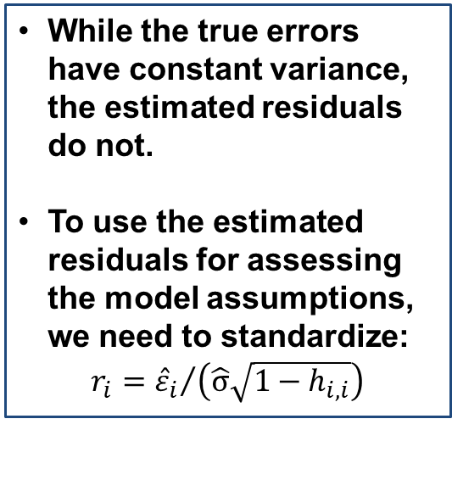
Properties of the Errors & Residuals
Properties of (true) errors:
  E($ε_{i}$) = 0
  Var($ε_{i}$) = ${\text{σ}}^{2}$
  E($ε$) = 0
  Var($ε$) = ${\text{σ}}^{2}I$
Properties of the (estimated) residuals:
  $\hat{ε}=Y−X\hat{β}$
  $E\left(\hat{ε}\right)=0$ (or E(${\hat{ε}}_{i}$) = 0)
  V($\hat{ε}$) = ${\text{σ}}^{2}\left(I−H\right)$ (or Var(${\hat{ε}}_{i}$) = ${\text{σ}}^{2}\left(1−h_{i,i}\right)$
    Where $H$ is the hat matrix, and $h_{i,i}$ is the i-th element on its diagonal
While the true errors have constant variance, the estimated residuals do not.
To use the estimated residuals for assessing the model assumptions, we need to standardize:
$$r_{i}={{\hat{ε}}_{i}}/{\left(\hat{\text{σ}}\sqrt{1−h_{i,i}}\right)}$$

Slide 6
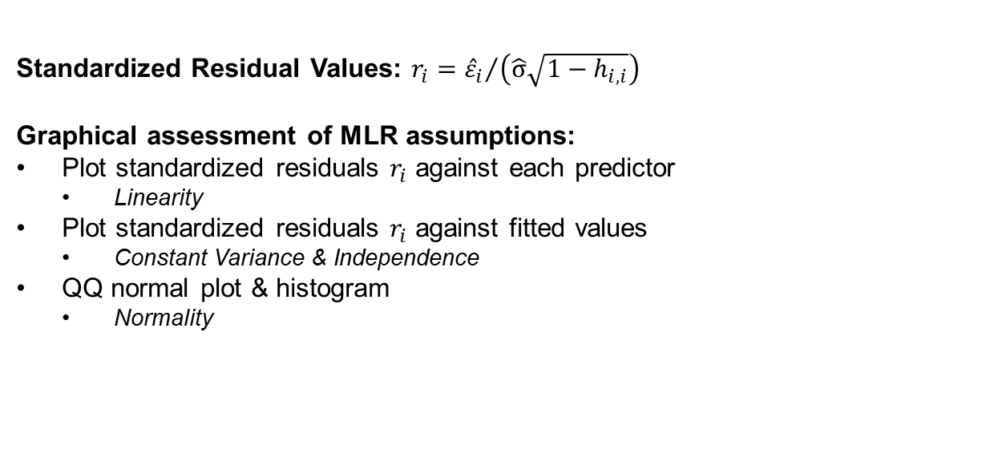
Residuals Analysis
Standardized Residual Values: $r_{i}={{\hat{ε}}_{i}}/{\left(\hat{\text{σ}}\sqrt{1−h_{i,i}}\right)}$
Graphical assessment of MLR assumptions:
Plot standardized residuals $r_{i}$ against each predictor
  Linearity
Plot standardized residuals $r_{i}$ against fitted values
  Constant Variance & Independence
QQ normal plot & histogram
  Normality

Slide 7
Residuals Analysis
Standardized Residual Values: $r_{i}={{\hat{ε}}_{i}}/{\left(\hat{\text{σ}}\sqrt{1−h_{i,i}}\right)}$
Graphical assessment of MLR assumptions:
Plot standardized residuals $r_{i}$ against each predictor
  Linearity
Plot standardized residuals $r_{i}$ against fitted values
  Constant Variance & Independence
QQ normal plot & histogram
  Normality
We evaluate the normality assumption using the residuals, not the response variable.
We do not check the predicting variables for normality.
However, if the distribution of a predicting variable is strongly skewed, it is possible that the linearity assumption with respect to that variable will not hold.

Slide 8
Residual Analysis: Linearity Assumption
Linearity: Plot the residuals against each predicting variable.
This shows that there may be a non-linear relationship between X and Y.

Slide 9

Residual Analysis: Constant Variance Assumption
Constant Variance: Plot the residuals against fitted values.
The residuals show larger variance as the predicting variable increases.
e
$$\hat{y}$$
Here, it is an example for which σ² is not constant.

Slide 10
Residual Analysis: Independence Assumption
Independence (uncorrelated errors): Plot the residuals against fitted values.
e
$$\hat{y}$$
There are clusters of residuals.
The independence assumption does not hold.

Slide 11
Residual Analysis: Independence Assumption
Residual Analysis: Independence Assumption
Independence (uncorrelated errors): Plot the residuals against fitted values.
Using residual analysis, we are actually checking for uncorrelated errors, not independence.
Independence is a more complicated matter. If the data are from a randomized experiment, then independence holds, but most data are from observational studies.
We commonly correct for selection bias in observational studies using controlling variables.
e
$$\hat{y}$$
There are clusters of residuals.
The independence assumption does not hold.

Slide 12
Checking the Assumption of Normality
One way to check this assumption in a regression is using a Normal Probability (Q-Q) Plot
y-axis: e_{i}
Let the R statistical software do this for you!
A straight line in a normal probability plot implies that the assumption is valid
Curviture (especially at the ends) shows non-normality
x-axis:
r_{i} = rank of e_{i} (between 1, n)
Φ = CDF of Normal Distribution

Slide 13
Residual Analysis: Normality Assumption
A complementary approach for checking for the normality assumption is by plotting the histogram of the residuals.
Normality Assumption:
The residuals should have an approximately symmetric, unimodal distribution, with no gaps in the data.

Slide 14
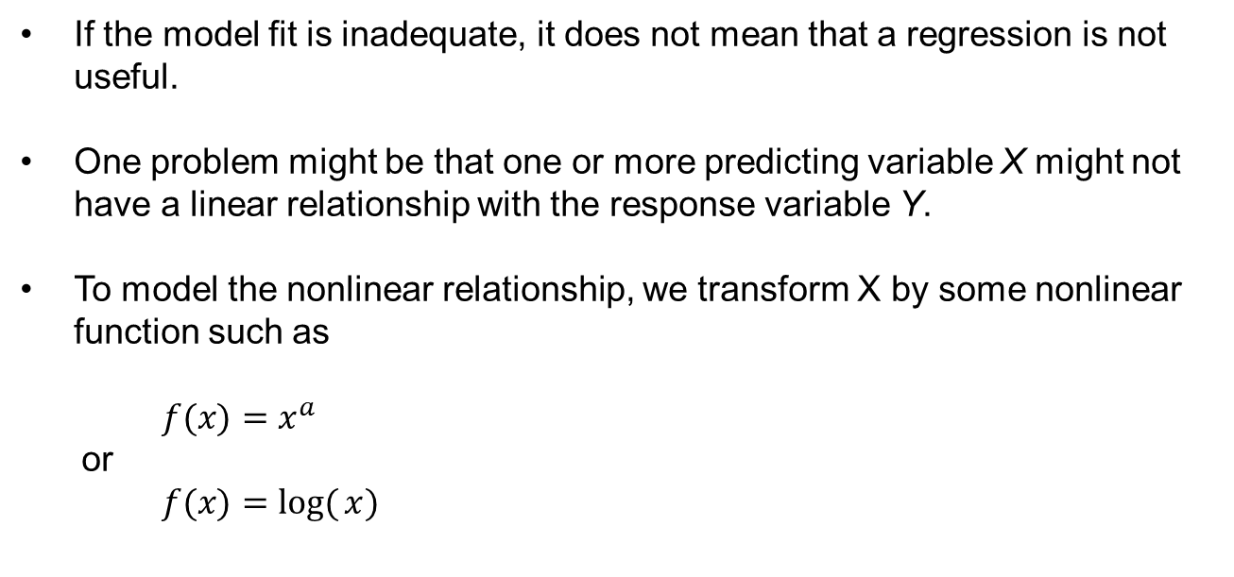
Predicting Variable Transformation
If the model fit is inadequate, it does not mean that a regression is not useful.
One problem might be that one or more predicting variable X might not have a linear relationship with the response variable Y.
To model the nonlinear relationship, we transform X by some nonlinear function such as
$$f(x)=x^{a}$$
  $$\text{or}$$
$$f(x)=\log{(}x)$$

Slide 15

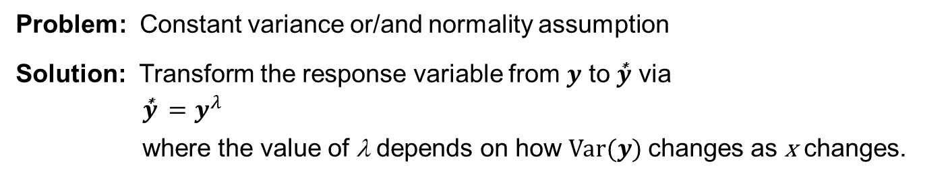


Normality Transformation
Problem: Constant variance or/and normality assumption
Solution: Transform the response variable from $y$ to $\overset{\text{∗}}{y}$ via
$$\overset{\text{∗}}{y} =y^{λ}$$
where the value of λ depends on how Var($y$) changes as x changes.
(don’t transform)
$\overset{\text{∗}}{y} =$ $\sqrt{y}$
$\overset{\text{∗}}{y}$ = ln($y$)
$\overset{\text{∗}}{y}$ = $\frac{1}{y}$

Slide 16
Outliers in Regression
A data point far from the majority of the data (in y and/or any x) may be called an outlier, especially if it does not follow the general trend of the rest of the data.
Data points that are far from the means of the Xs or near the edge of the observation space are called leverage points.
A data point that is far from the means of y and/or an x is called an influential point if it influences the fit of the regression.
Excluding a leverage point may or may not the regression fit significantly, thus a leverage point may or may not be an influential point.
The upshot: Sometimes there are good reasons to exclude subsets of data (e.g., errors in data entry or experimental errors). Sometimes an outlier belongs in the data. Outliers should always be examined.
Notes:
An outlier is an observation that is unusually small or large.
Often a regression line will differ greatly depending upon what subsets of the data are included.

Slide 17
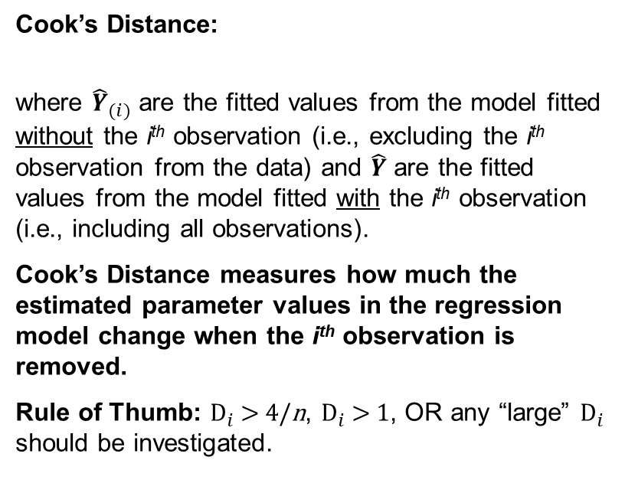
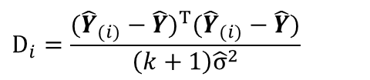
Checking for Outliers
$$D_{i}=\frac{({\hat{Y}}_{(i)}−\hat{Y})^{T}({\hat{Y}}_{(i)}−\hat{Y})}{\left(k+1\right){\hat{σ}}^{2}}$$
Cook’s Distance:
where ${\hat{Y}}_{(i)}$ are the fitted values from the model fitted without the i^{th} observation (i.e., excluding the i^{th} observation from the data) and $\hat{Y}$ are the fitted values from the model fitted with the i^{th} observation (i.e., including all observations).
Cook’s Distance measures how much the estimated parameter values in the regression model change when the i^{th} observation is removed.
Rule of Thumb: $D_{i}$ > 4/n, $D_{i}$ > 1, OR any “large” $D_{i}$ should be investigated.

Slide 18
Checking for Outliers
$$D_{i}=\frac{({\hat{Y}}_{(i)}−\hat{Y})^{T}({\hat{Y}}_{(i)}−\hat{Y})}{\left(k+1\right){\hat{σ}}^{2}}$$
Cook’s Distance:
where ${\hat{Y}}_{(i)}$ are the fitted values from the model fitted without the i^{th} observation (i.e., excluding the i^{th} observation from the data) and $\hat{Y}$ are the fitted values from the model fitted with the i^{th} observation (i.e., including all observations).
Cook’s Distance measures how much the estimated parameter values in the regression model change when the i^{th} observation is removed.
Rule of Thumb: $D_{i}$ > 4/n, $D_{i}$ > 1, OR any “large” $D_{i}$ should be investigated.
Outliers: are those few observations with much larger Cook’s distance than the rest of observations;
If a large number of outliers, then they probably point to a heavy tailed distribution rather than truly extreme values.

Slide 19

Summary

